Slide 1















Hermes: Efficient and Secure Multi-Writer Encrypted Database
Tung Le, Thang Hoang
{tungle, thanghoang}@vt.edu
Virginia Tech
IEEE Symposium on Security and Privacy 2025
San Francisco, CA
Notes:
Hello everyone, now I’m going present our work “Hermes: Efficient and Secure Multi-Writer Encrypted Database”.
I’m Tung Le from Virginia Tech. This is the joint work with my advisor Thang Hoang.

Slide 2













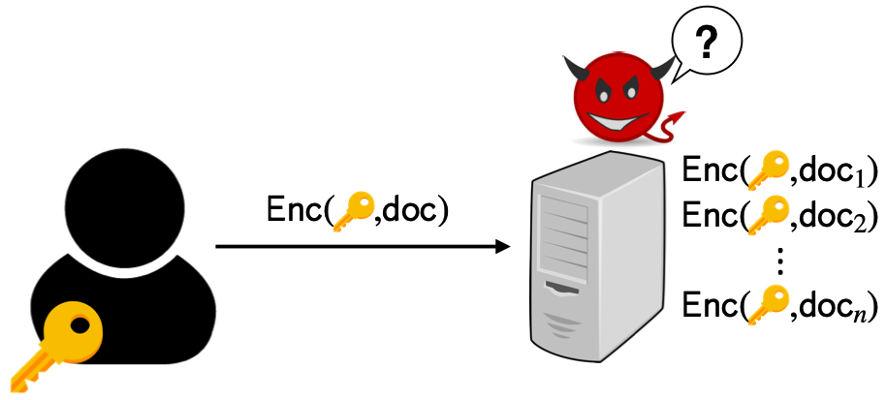






Storing/Collecting Data with Cloud
Cloud services reduce the burden of locally-stored ever-growing data
They also provide a platform for multi-writer applications:
Email/messaging
EHR systems
Collaborative applications
Yet, it is doubtful whether the cloud server can be trusted. How to secure outsourced data while enabling efficient search?
Storage-as-a service (STaaS)
Notes:
Nowadays, data outsourcing services have become essential in our daily lives.
These systems provide additional space for data storage, reducing burden on user devices that have limited capacity.
Also, they play the role as platforms for sharing data between multiple users.
However, despite their merits, there is a privacy concern regarding user data.
It is expected that cloud services can support secure search over data while ensuring data privacy is not compromised.

Slide 3



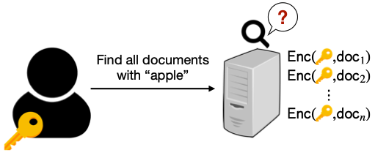
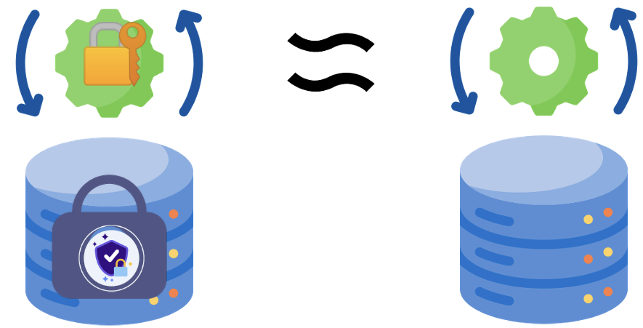






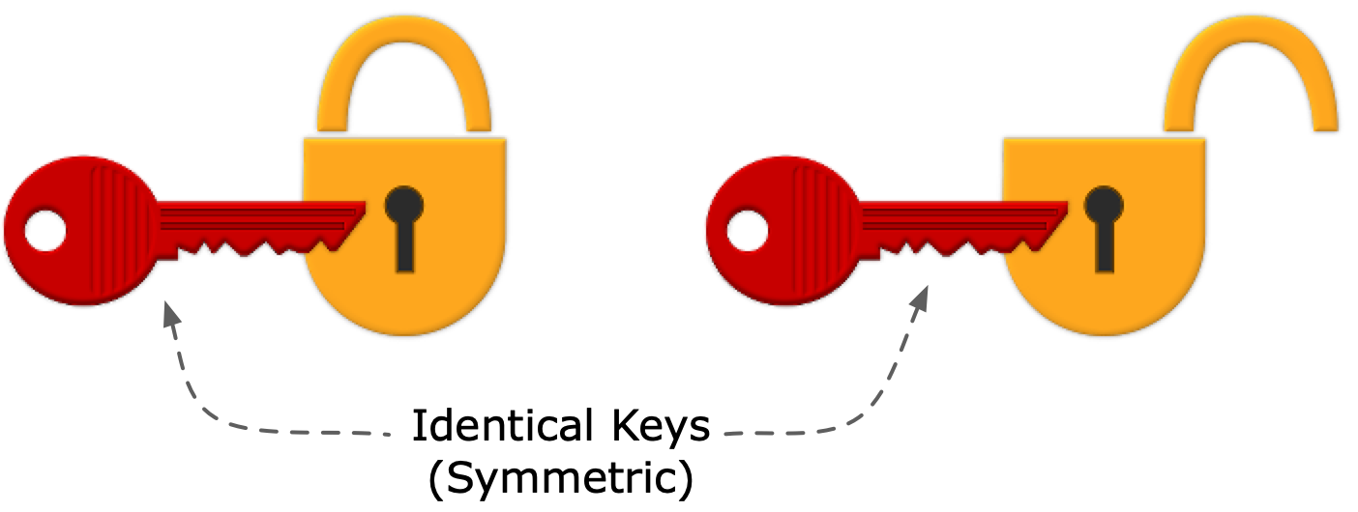
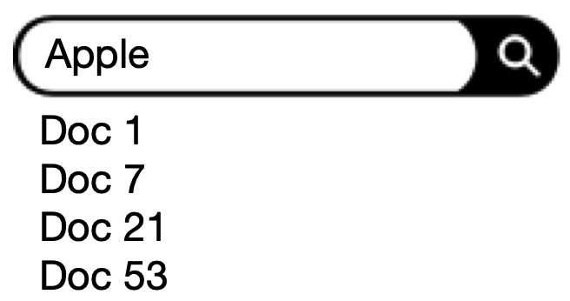


Searching Encrypted Data
utilities
privacy
Standard encryption prevents any data querying/search
Multi-Client ORAM or FHE are too heavyweight
Searchable Encryption (SE) is promising
Realize nice security-efficiency trade-offs for searching encrypted data
Two well-studied SE notions
Dynamic Searchable Symmetric Encryption (DSSE) [KPR12]
Public-Key Searchable Encryption (PKSE) [BDOP04]
Notes:
Encryption can protect the confidentiality of data.
However, it prevents the capabilities that can be executed on plaintext data, such as querying or search.
Costly cryptographic tools like Multi-Client ORAM of Fully-Homomorphic Encryption incur a lot of overhead.
Searchable Encryption has been studied and developed since 2000.
It is promising in realizing efficient searchability over encrypted data.
Searchable Encryption schemes are categorized into two main groups: Searchable Symmetric Encryption and Public-Key Searchable Encryption.

Slide 4





















Representative SE Notions: DSSE
buy
:
tax
:
bill
:
Sublinear Search Complexity
Encrypted index allows efficient search
Ensure Forward Privacy
Protect privacy of future updates by “changing” update tokens
Mainly Support Single-User Settings
Writer = Reader = Secret-Key Owner
Fails for contributive applications
“bill”
Notes:
For the pros and cons of the first category, dynamic searchable symmetric encryption, or DSSE.
DSSE schemes have encrypted search index that is prebuilt to enable efficient search.
Therefore, the search complexity of DSSE is sublinear in database size.
The user in DSSE knows the current state of update.
So it can easily ensure forward privacy by incrementing the counter state for future update tokens.
However, it mostly considers single-user settings or assumes all users in the system are trusted.

Slide 5
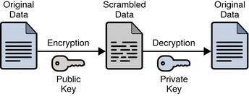


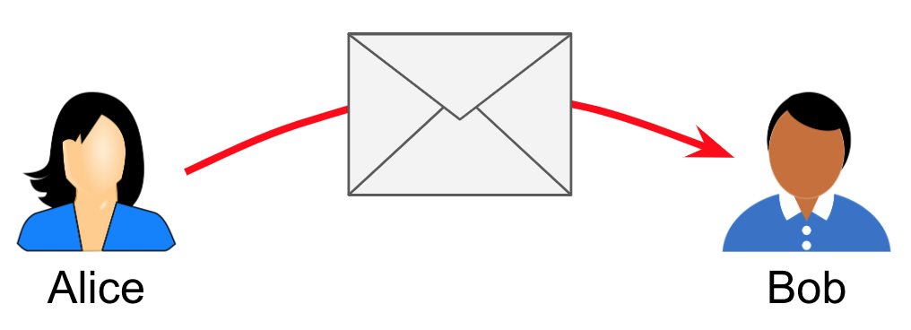








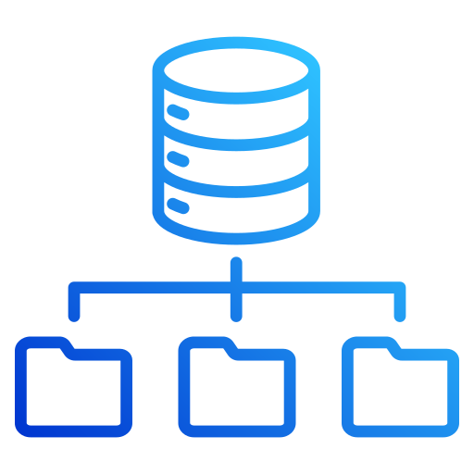




Representative SE Notions: PKSE
Multi-Writer Support
No secret-key distribution
No synchronous communication
Linear Search Complexity
Obstacle to build joint search index without shared secret
and coordination between reader and writers
Lack of Forward Privacy
Writers don’t know any search states to change update tokens
Has search happened?
Notes:
For the plus and minus of the second category, Public-key Searchable Encryption, or PKSE.
PKSE can support multi-writer. For example in email, the writers are the senders, and the reader is the receiver.
The reader doesn’t have to distribute its secret key to the writers.
The writers don’t need synchronization to start communicating with the reader.
However, the main drawback of PKSE is its search complexity, which is linear in database size.
Another disadvantage is that PKSE is much harder to ensure forward privacy.
The reason is that there is no communication between the reader and the writers, so the writers don’t know the current search state to change update tokens.

Slide 6





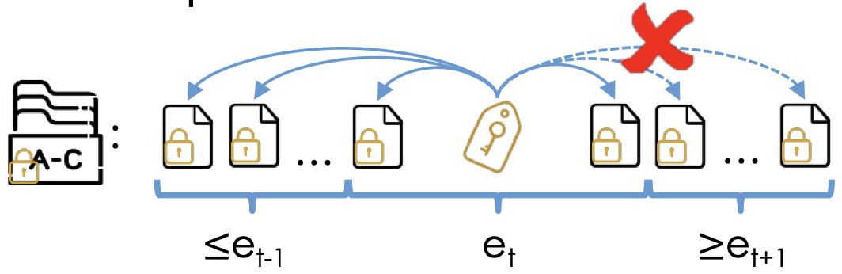










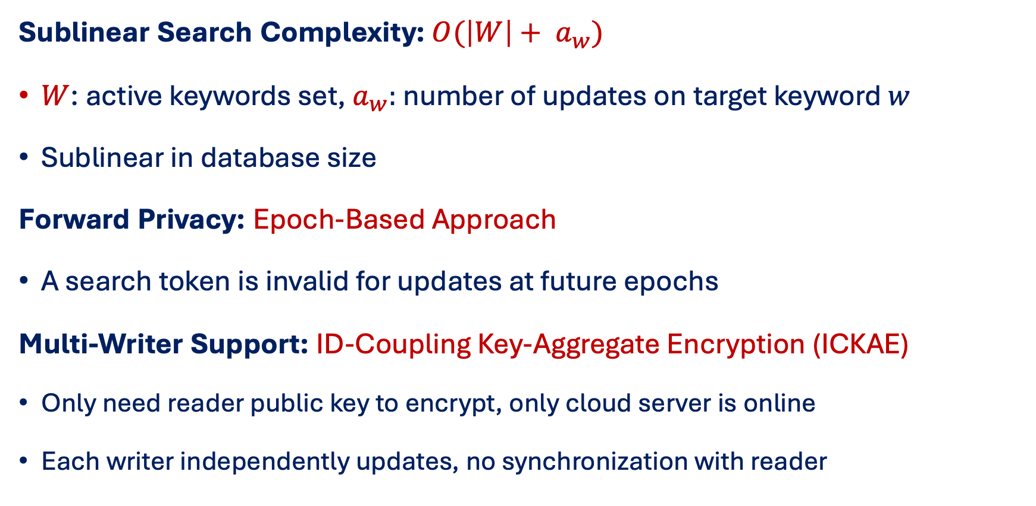
Towards the Best of Both Worlds: Hybrid SE
Advantages of Hybrid Searchable Encryption (HSE):
Sublinear Search Complexity:$O(\left|W\right|+ a_{w})$
$W$: active keywords set, $a_{w}:$ number of updates on target keyword $w$
Sublinear in database size
Forward Privacy: Epoch-Based Approach
A search token is invalid for updates at future epochs
Multi-Writer Support: ID-Coupling Key-Aggregate Encryption (ICKAE)
Only need reader public key to encrypt, only cloud server is online
Each writer independently updates, no synchronization with reader
Notes:
In 2022, a new searchable encryption model was proposed, which is called hybrid searchable encryption, or HSE.
The purpose of HSE is to achieve the best of both worlds.
In particular, the search complexity of HSE is sublinear in database size, which is linear in the number of keywords and updates on the target keyword.
Moreover, HSE can achieve epoch-based forward privacy.
And lastly, HSE can support multi-writer with a cryptographic primitive called id-coupling key-aggregate encryption or ICKAE.
The writers only need the public key of the reader to encrypt and contribute data, and don’t need synchronous communication with the reader.

Slide 7


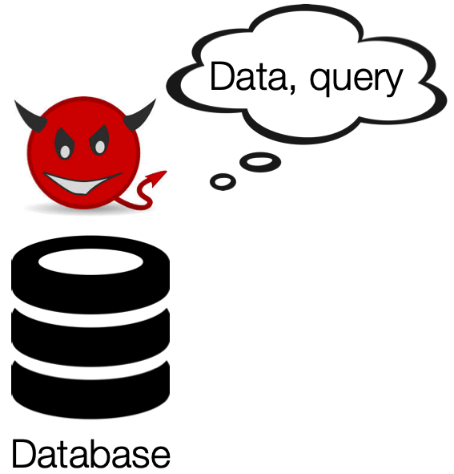
















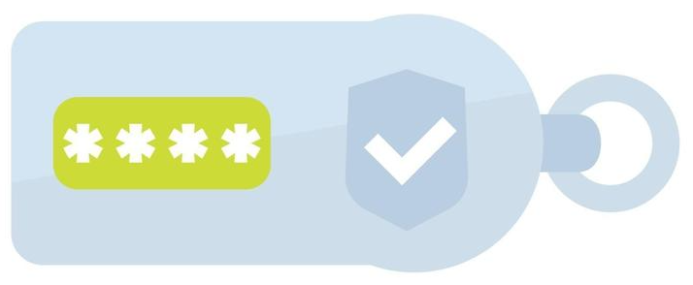




Shortcomings of State-of-the-Art HSE
Vulnerable to keyword-guessing (dictionary) attacks
Search complexity is linear in keyword set size
Significant user overhead to ensure forward privacy
?
 | “IEEE S&P”
 | “Oakland”
 | “California”
 | “”San Francisco”
 | “Hermes”
Notes:
However, the state-of-the-art HSE still has notable disadvantages.
First, it is vulnerable to keyword-guessing attacks.
Second, the search complexity of HSE is sublinear in database size, but still linear in the number of keywords.
For a large number of keywords, the search latency is significant.
Finally, the writers need to rebuild search index periodically to ensure forward privacy, which incurs a lot of overhead on the writer side.
Our work aims to deal with all these issues.

Slide 8

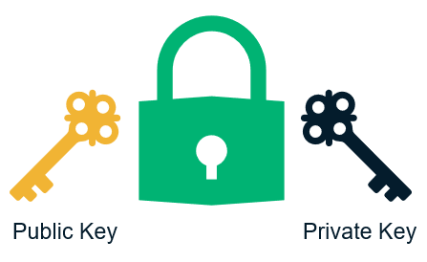

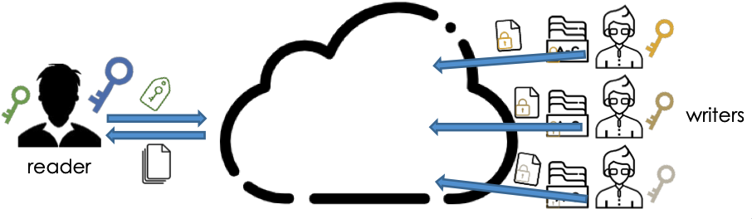




System, Theat and Security Models
An honest reader who holds a public/private key pair
Multiple writers, where each owns its independent database
A server that stores database of writers and executes queries
The server and some of the writers can be corrupt. The adversary is semi-honest
Notes:
Before going into our ideas to improve HSE, I am talking about system and threat models.
We consider the same setting as the hybrid searchable encryption.
Our system has an honest reader who holds a public and private key pair.
There can have an arbitrary number of writers, in which any writer can be corrupt.
Each writer has an independent database.
And an untrusted server, which stores data and executes queries from the reader and writers.
We assume the adversary is semi-honest.
In our system, the writers contribute and share data with the reader.
The reader executes search over database of writers.

Slide 9











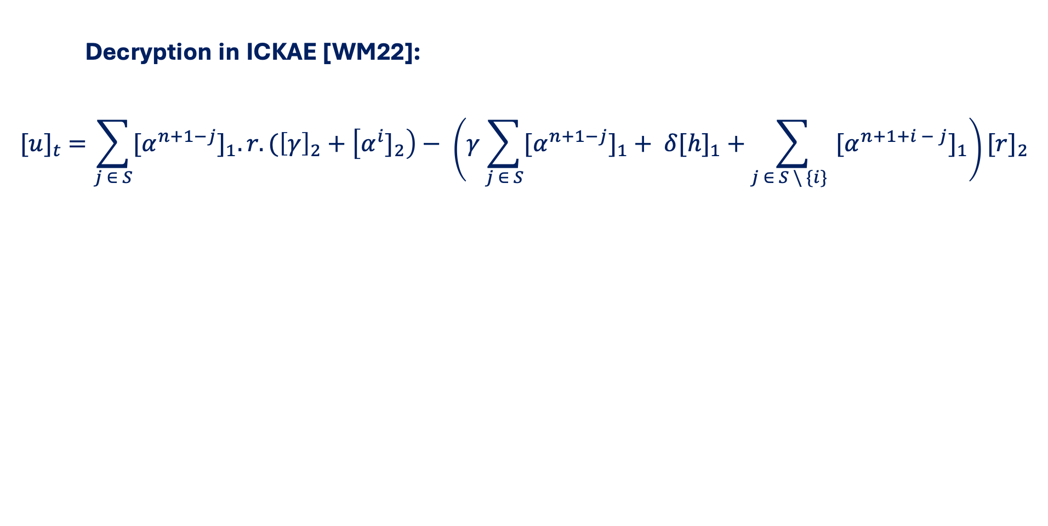
Idea 1: Hidden-ID Key-Aggregate Encryption
Decryption in ICKAE [WM22]:
$${[u]}_{t} =\sum_{j ∈ S}{{{[α}^{n+1−j}]}_{1}.r.({\left[γ\right]}_{2}+\left[{α^{i}]}_{2}\right)− \left(γ\sum_{j ∈ S}{{{[α}^{n+1−j}]}_{1}}+ δ{[h]}_{1} +\sum_{j ∈ S \backslash \{i\} }{{{[α}^{n+1+i − j}]}_{1}}\right)}{[r]}_{2}$$
ciphertext
$$H(w)$$
correlation
ciphertext
public
aggregated key
public
We design a new primitive called Hidden-ID Coupling KAE to prevent keyword-guessing attacks
High-level ideas:
Each writer has a secret and embeds it into ciphertext
→ Prevent trying matching arbitrary IDs with given aggregated keys
Set up correlations between any two writers
→ Achieve key-aggregate property for confined search
Features: confidentiality, anonymity, and hidden-ID
San Jose?
San Diego?
San Francisco?
Notes:
I’ll talk about our first idea to prevent keyword-guessing attacks.
Key-Aggregate Encryption means that with only one decryption key, it can be used to decrypt ciphertexts created by different writers.
This is the formula of decryption process in ICKAE between an aggregated key and ciphertext of a writer.
We realize that the important part to achieve key-aggregate property is the correlation value.
So, we designed a new primitive called Hidden-ID Coupling Key-Aggregate Encryption, which advances the existing ICKAE to prevent keyword-guessing attacks.
Our high-level idea is to let each writer have a secret, which is embedded into ciphertext.
The purpose is to prevent adversaries from creating ciphertext itself and try decrypting it with the given decryption key.
The challenge is to achieve key-aggregate property for confined search. We do that by securely setting up correlations between any two writers.
For more details, please have a look at our paper.
Briefly, our Hidden-ID Coupling KAE ensures the confidentiality and anonymity for ciphertext, and hidden-ID for aggregated keys.

Slide 10







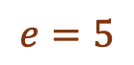
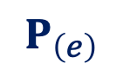


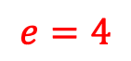
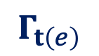
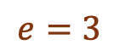
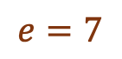

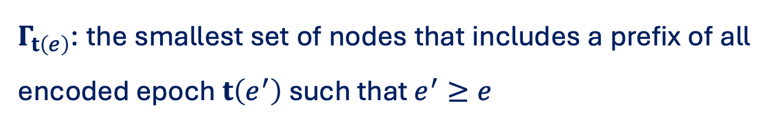

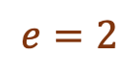
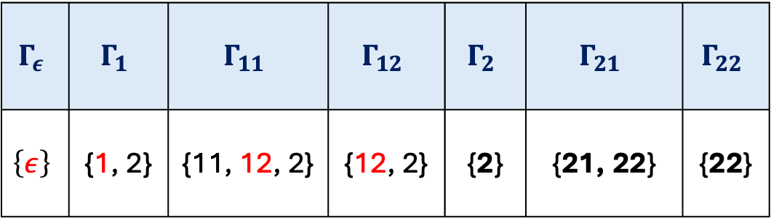
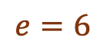


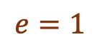
Idea 2: Forward Privacy via Epoch Encoding
$$e=1$$
$$Γ_{ε}$$ | $$Γ_{1}$$ | $$Γ_{11}$$ | $$Γ_{12}$$ | $$Γ_{2}$$ | $$Γ_{21}$$ | $$Γ_{22}$$
$$\left\{ε\right\}$$ | {1, 2} | {11, 12, 2} | {12, 2} | {2} | {21, 22} | {22}
$$ε$$
1
2
$$e=2$$
$$1$$
$$2$$
$$e=5$$
1
2
1
2
$Γ_{t\left(e\right)}$: the smallest set of nodes that includes a prefix of all encoded epoch $t\left(e^{′}\right)$ such that $e^{′}≥e$
$$11$$
$$12$$
$$21$$
$$22$$
$$e=3$$
$$e=4$$
$$e=6$$
$$e=7$$
Epoch $e=4$ is encoded as $t\left(4\right)=12$, and $P_{12}=\left\{ε, 1, 12\right\}$
Tree-based Epoch Encoding
$Γ_{ε}, Γ_{1}, Γ_{11}, Γ_{12}$ (epochs $e^{′}≤4)$all contain some value in $P_{12}$
$$Γ_{t\left(e\right)}$$
However, $Γ_{2}, Γ_{21}, Γ_{22}$ (epochs $e^{′}>4)$does not
Encryption/Ciphertext
Forward Privacy with Efficiency
Trade-Off: An Increase $O\left(λ\right)$ in Update Complexity
$$P_{\left(e\right)}$$
Decryption/Aggregated Key
Notes:
Our second idea is to achieve forward privacy via Epoch Encoding.
The purpose is to avoid costly rebuild in the existing work.
You can see the tree-based epoch encoding works as illustrated here.
With a three-level binary tree for encoding 7 epochs, where 1 denotes taking the left branch, and 2 denotes taking the right-branch.
Each epoch is associated with a gamma set in this table. For how to compute this set for each epoch, you can refer to our paper.
When creating ciphertext, we use the values in the gamma set.
And when creating decryption key, we use values of nodes from the root to the current epoch node, which we call the prefix set.
For example, with epoch number 4, all the gamma sets of previous epochs contain some value in the prefix set of epoch number 4.
However, the gamma set of any epoch greater than 4 doesn’t.
So, the decryption key created at epoch number 4 cannot decrypt ciphertexts at epochs later than 4.
This can ensure the privacy of future updates, thereby achieving forward privacy.
The trade-off is that the update complexity is increased by a factor of lambda, since the tree-depth will be lambda, similarly for the size of the gamma set and prefix set.

Slide 11

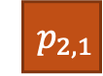



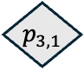
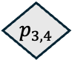




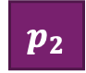



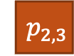
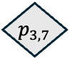


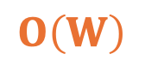



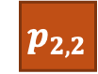



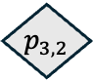


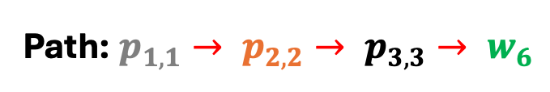

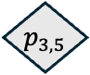


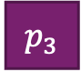


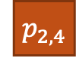




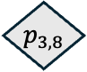

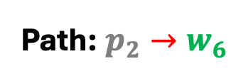
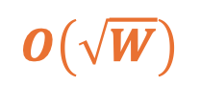
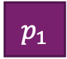


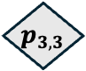

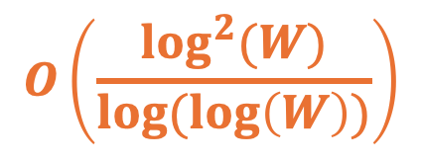

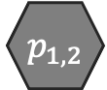
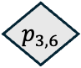






Idea 3: Partitioning for Sublinear Search
$${ w}_{1}$$
$${ w}_{2}$$
Path: $p_{2}→w_{6}$
Path: $p_{1,1}→ p_{2,2}→ p_{3,3}→ w_{6}$
$${ w}_{1}$$
$${ p}_{3,1}$$
$${ w}_{3}$$
$${ w}_{2}$$
$${ p}_{3,2}$$
$${ w}_{4}$$
$${ w}_{3}$$
$${ p}_{2,1}$$
$${ w}_{1}$$
$${ w}_{5}$$
$${ w}_{4}$$
$${ p}_{1}$$
$${ w}_{6}$$
$${ w}_{5}$$
$${ p}_{2,2}$$
$${ p}_{3,3}$$
$${ w}_{2}$$
$${ p}_{1,1}$$
$${ w}_{6}$$
$${ w}_{7}$$
$${ p}_{2}$$
$${ p}_{3,4}$$
$${ w}_{7}$$
$${ w}_{8}$$
$${ w}_{3}$$
Partitioning
Recursive
Partitioning
$${ w}_{8}$$
$${ w}_{9}$$
$${ p}_{3}$$
$${ p}_{1,2}$$
$${ p}_{3,5}$$
…
$${ w}_{9}$$
$${ w}_{10}$$
$${ w}_{10}$$
$${ p}_{2,3}$$
$${ p}_{3,6}$$
$${ w}_{11}$$
$${ w}_{15}$$
$${ p}_{4}$$
$${ w}_{11}$$
$${ w}_{12}$$
$${ w}_{12}$$
$${ p}_{2,4}$$
$${ p}_{3,7}$$
$${ w}_{13}$$
$${ w}_{16}$$
$${ w}_{13}$$
$${ w}_{14}$$
$${ w}_{14}$$
$$O\left(\frac{\log^{2}(W)}{log(log\left(W\right))}\right)$$
$${ p}_{3,8}$$
$$O\left(W\right)$$
$$O\left(\sqrt{W}\right)$$
$${ w}_{15}$$
$${ w}_{15}$$
$${ w}_{16}$$
$W$: Keyword Set Size
$${ w}_{16}$$
Notes:
Our third idea is to optimize the search complexity from linear to sublinear.
In the existing HSE, the given search token executes matching decryption for each keyword in the database.
Therefore, the cost is linear in the number of keywords.
To reduce this cost to square root in the number of keywords, we can distribute the keywords into partitions, where the number of partitions is square root the number of keywords.
Each partition has square root the number of keywords items.
So there will be two search tokens, one for partition matching, and another for keyword matching.
By doing so, we can reduce the search complexity from linear to square root.
If the size of partitions after the first partitioning step is still too large, we can apply this strategy recursively, until each partition has log number of keywords items.
Then, the search complexity can be optimized to O(log square divided by log log).
The trade-off is that the search token size will increase based on the number of partitioning levels.

Slide 12











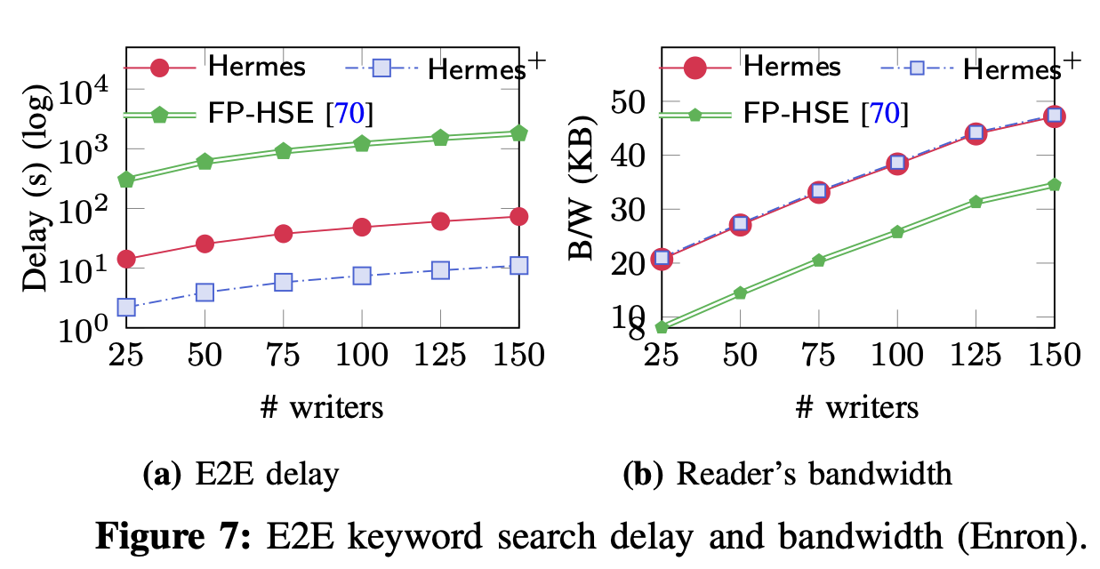
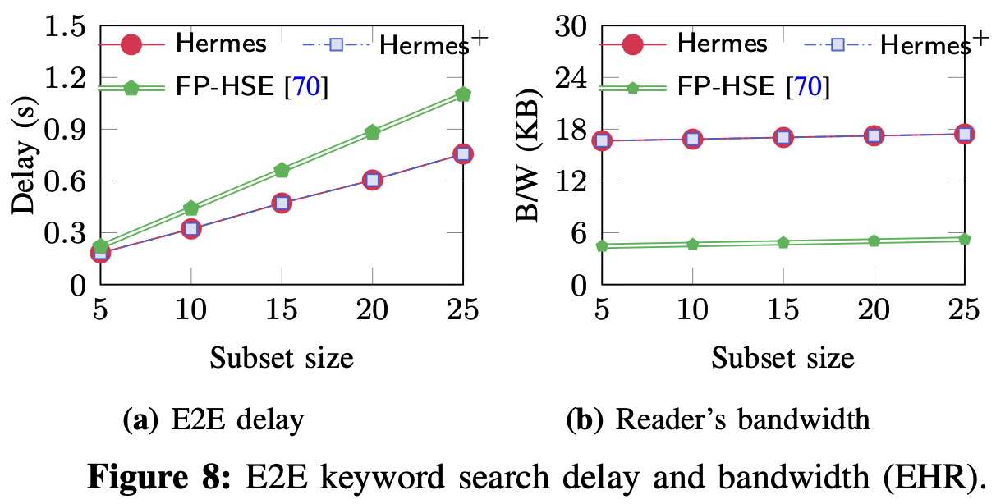
Experimental Evaluation
Keyword Search
Hermes executes search up to two orders of magnitude faster than FP-HSE [WM22] while preventing keyword-guessing attacks
Notes:
We compare our Hermes with the state-of-the-art scheme named forward-private hybrid searchable encryption.
Regarding keyword search performance, our Hermes is up to two orders of magnitude faster.
More importantly, Hermes achieves a higher security guarantee since it can prevent keyword-guessing attacks.

Slide 13




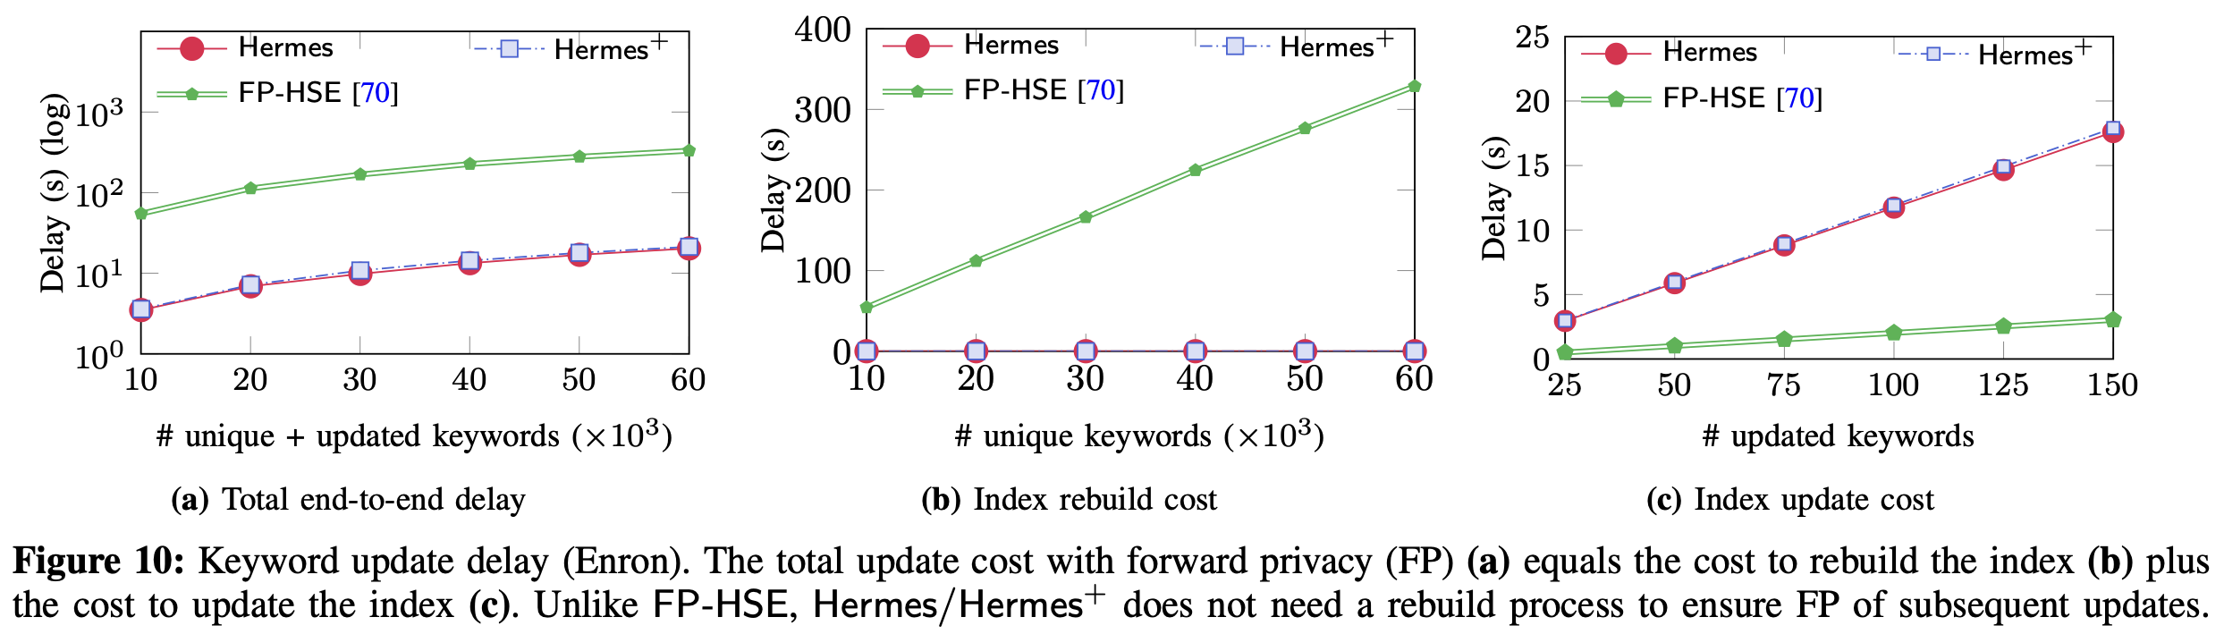





Experimental Evaluation
Keyword Update
Hermes executes update 3.8× - 17.1× faster than FP-HSE
Notes:
Related to update performance, because Hermes doesn’t require costly rebuild to maintain forward privacy, the update overhead on the writer is significantly lower.
In particular, Hermes executes update 4 to 17 times faster than forward-private HSE.

Slide 14













Summary
Our Hermes simultaneously achieves:
Security Against Keyword-Guessing Attacks
A New Primitive: Hidden-ID Key-Aggregate Encryption
Sublinear Search Complexity (in Keyword Set Size)
Partitioning/Recursive Partitioning
User-Efficient Forward Privacy
Tree-based Epoch-Encoding Technique
Notes:
In summary, we designed a new multi-writer searchable encrypted system that advances the state-of-the-art in three aspects:
First, Hermes achieves security against keyword-guessing attacks.
Second, the search complexity of Hermes is sublinear in keyword set size.
Finally, Hermes can ensure forward privacy with minimal overhead on the user.

Slide 15

THANK YOU FOR YOUR ATTENTION
Notes:
This is the end of my presentation. Thank you for your attention.

Slide 16
References
[BDOP04] Dan Boneh, Giovanni Di Crescenzo, Rafail Ostrovsky, and Giuseppe Persiano. Public key encryption with keyword search. Cryptology ePrint Archive, Paper 2003/195, 2003.
[KPR12] Seny Kamara, Charalampos Papamanthou, and Tom Roeder. 2012. Dynamic searchable symmetric encryption. In Proceedings of the 2012 ACM conference on Computer and communications security (CCS '12).
[WM22] Jiafan Wang and Sherman S. M. Chow. Omnes pro uno: Practical Multi-Writer encrypted database. In 31st USENIX Security Symposium (USENIX Security 22), pages 2371–2388, Boston, MA, August 2022. USENIX Association.

